Slide 1
Economy-wide Impacts of the Inflation Reduction Act Energy Provisions Modeling Methodology
More than
Global professional, technology and marketing services firm
5,000
People
Headquartered in Washington, D.C. with:
67
80
Offices
Nationalities
Speaking more than
70
$1.2B
In annual revenue
Languages
October 10, 2024

Slide 2
Disclaimer
This report was prepared by ICF for American Clean Power, based on certain limited information, methodologies, assumptions, instructions, and directions and under the circumstances applicable at the time the report was prepared. No independent verification of certain information provided to ICF for the purposes of its analysis, or whether such information has changed since it was provided, was conducted. Different or additional information, methodologies, assumptions, or circumstances could lead to different results; therefore, actual future results may differ materially from those presented in this report. ICF does not make any representation with respect to the likelihood of any future outcome or the accuracy of any information herein or any conclusions based thereon. ICF is not responsible for typographical, pictorial, or other editorial errors.
Any use of this report other than as a whole and in conjunction with this notice is prohibited. This report is provided AS IS. NO WARRANTY, WHETHER EXPRESS OR IMPLIED, INCLUDING THE IMPLIED WARRANTIES OF MERCHANTABILITY AND FITNESS FOR A PARTICULAR PURPOSE, IS GIVEN OR MADE BY ICF IN CONNECTION WITH THIS REPORT. You use this report at your own risk. ICF is not liable for any damages of any kind attributable to your use of this report. ICF is a non-partisan, non-political company that delivers a broad and diverse range of independent, unbiased, objective analyses and related consulting services to help its clients meet their missions. This report may not be construed as ICF’s endorsement of any policy or any regulatory, lobbying, legal, or other advocacy position, organization, or political party. Any conclusions presented herein do not necessarily represent the policy or political views of ICF. ICF’s services do not constitute legal or tax advice.

Slide 3
Study Background
On August 16, 2022, the Inflation Reduction Act (IRA) went into effect
Providing billions in tax credits, rebates, and other incentives for clean energy deployment
Supporting investments in clean energy projects
Expanding domestic supply-chains
Supporting jobs and other economic benefits
Lowering greenhouse gas (GHG) emissions
This study seeks to estimate incremental economy-wide impacts of IRA
Results capture net additional economic benefits attributable to IRA that are beyond those benefits that occur due to state policies and clean energy activity that is expected regardless of IRA
Combining state-of-the-art sector modeling and macroeconomic modeling
Individual sector models for power, transportation, buildings, and fuels to project impacts of IRA on each market segment
Macroeconomic modeling uses sector projections to estimate economic impacts
Full accounting of benefits and costs
Modeling includes not just the positive impacts, but also the costs of funding IRA, displaced economic activities (e.g., displaced fuels), and costs of private sector financing
¹See slide 27 for a list of acronyms.

Slide 4
Study Methodology
Incentives: Review of all IRA energy incentives by sector
Power (45Y, 48E, 45Q, 45U), Transportation (30D, 45W, 30C), Buildings (25C, 25D, 179D, 45L, HOMES, HEAR), Hydrogen (45V), Sustainable Aviation Fuel (45Z, 40B), and Manufacturing (48C, 45X).
Sector Modeling: Develop projections of incremental IRA sector impacts
ICF’s CO₂Sight platform (IPM, EPA MOVES4, DER Planner) supported with market analyses.¹
Sector modeling outputs such as costs of investments/purchases, prices, fuel consumption, operating and maintenance are key REMI inputs.
Macroeconomic Modeling: REMI modeling of incremental IRA impacts
Conversion of scenario outputs to REMI model inputs.
REMI Results: jobs², gross domestic product (GDP), household income.
State Results: Downscaling of regional incremental IRA impacts
Regional REMI results downscaled to state level.
Each modeled sector’s regional results apportioned to states using a variety of data sources and assumptions.
¹See slide 27 for a list of acronyms.
²Jobs include direct jobs associated with investments, supply-chain jobs (indirect jobs), and jobs associated with spending from increased incomes (induced jobs).

Slide 5
Sector Modeling Methodology

Slide 6
IRA Impacts Scenario Development
Sector Modeling Methodology
To estimate the increment effects of IRA's energy provisions, ICF modeled two scenarios: one where IRA does not exist (no-IRA baseline) and a second where IRA incentives are available (IRA scenario)
The difference between the two scenarios results in IRA’s incremental impacts
The two scenarios were developed for six sectors: Power, Transportation, Buildings, Hydrogen, Sustainable Aviation Fuel (SAF), and Manufacturing
To create the scenarios, ICF used an integrated modeling platform, CO₂Sight that contains models for three sectors: Power (Integrated Planning Model [IPM®]), Transportation (Environmental Protection Agency [EPA] Motor Vehicle Emission Simulator [MOVES4]), and Buildings (Distributed Energy Resources [DER] Planner)
For the Power sector, incentives were endogenously modeled in IPM to estimate their impact on generation, along with the incentive amounts distributed
For other models and analyses, ICF relied on reports, or Congressional Budget Office (CBO) forecasts of incentive payments, to determine incentive amounts distributed
The amount of incentive distributed is then used in the models to determine projected impacts on spending, costs, and energy changes
Further detail on modeling methodology is presented in subsequent slides
For sectors not included in the CO₂Sight platform, ICF used exogenous market analyses that use methods described in subsequent slides to develop scenarios:
Hydrogen (Wood Mackenzie,¹ adapted by ICF)
Sustainable Aviation Fuels [SAF] (ICF)
Manufacturing (ICF)
¹ Implications of 45V Guidance for the Future of the Green Hydrogen Industry. Study conducted by Wood Mackenzie and commissioned by American Clean Power (ACP). https://cleanpower.org/resources/45v-implications-on-green-hydrogen-industry/. This represents one potential pathway for hydrogen based on a particular set of regulatory rules. Final regulatory guidance may change the results.

Slide 7
CO₂Sight Modeling (Power, Transportation, and Buildings)
Sector Modeling Methodology
CO₂Sight integrates multiple modeling platforms such as IPM, EPA MOVES4, and DER Planner
Transportation and Buildings sector modeling to produce incremental electricity demand impacts
Post-processed into load shapes and used in IPM modeling to integrate analyses
Load shapes capture time-of-day patterns for electricity consumption by end-uses (e.g., vehicles, heat pumps) as well as regional variations
Load shapes play a large role in the generation capacity needed to meet peak electricity demand
IPM results (prices) used to monetize some outputs of other sectors (e.g., changes in electricity consumption)

Slide 8
Integrated Planning Model (Power)
Sector Modeling Methodology
Comprehensive and Realistic Coverage
Multi-regional, dynamic, long-term capacity expansion and production cost model
Incorporating existing federal- and state- level policies to produce a baseline consistent with existing drivers of the clean energy transition
Baseline for this study removes IRA incentives to produce the no-IRA baseline
Models key technologies for energy transition, including carbon capture and storage (CCS) and hydrogen produced by clean electrolysis (i.e., green hydrogen)
Incorporates capacity deployment constraints (i.e., how much can be built per year). Such constraints can be due to:
Production capacity limitations, including the number of engineering and construction (E/C) firms capable of executing large power projects in the U.S., the number of large projects each such firm can handle, and the number of multi-billion-dollar projects a firm can take on in parallel
General limitations in the domestic infrastructure for heavy manufacturing
Financial limitations – limitations on the number of projects that can obtain financing simultaneously at an acceptable level of risk
Workforce limitations - limitations on the skilled E/C labor force, replacement challenges caused by an aging workforce, on the one hand, and inadequate training infrastructure for new entrants, on the other
Market Representation
Endogenously represents power, fuel, and emission markets allowing for estimated impacts of all key parameters from IRA
Transmission Capabilities
Detailed representation of existing transmission capabilities between model regions
Transmission constraints specify maximum transmission capabilities
Emission Mitigation Policy Analysis
Develops baseline (no-IRA baseline) and policy (IRA) scenarios to estimate incremental impacts of IRA
Produces detailed outputs including generation dispatch, emissions, costs, and new unit builds
Estimates co-benefits of greenhouse gas (GHG) emission reductions from the Power sector

Slide 9
Power Sector Incentives in IPM
Sector Modeling Methodology
Production Tax Credit​ (45Y)
Technologies: new onshore wind, new solar photovoltaics (PV), new solar thermal, existing and new nuclear​
Modeled in IPM as a negative variable operation and maintenance (VOM)​
Follows EPA implementation for energy communities
Maps how much of an IPM region energy communities occupy and adjusts the bonus credit for the IPM region in proportion
Onshore wind receives domestic credit bonus beginning in 2028; other technologies (solar, offshore wind, storage) beginning in 2030
Investment Tax Credit​ (48E)
Technologies: new battery storage, new offshore wind​
Modeled using an escalation scalar applied to the technology’s capital expenditures (CAPEX)
Credit for Carbon Capture and Storage​ (45Q)
Credit is received for 12 years​
Credit amount is removed from the CCS storage cost curve​; 45Q is reapplied through a tax credit​
Zero-Emission Nuclear Power Production Credit (45U)
Because of this tax credit, ICF assumes nuclear does not retire
IRA includes provisions for transferability and direct pay that broaden the reach of tax credits by allowing for monetization by all entities
Transferability: for-profit project owners can monetize tax credits by selling them for cash, making it easier for clean energy projects to get financing by turning tax credits into immediate funds
Direct pay: public power utilities, rural electric cooperatives, and other tax-exempt entities can monetize credits by exchanging energy tax credits with a direct payment from the Internal Revenue Service equal to the amount of the credit
IPM treats all tax credits the same, however monetized, and therefore implicitly includes the increased efficiency and availability of cash from these provisions

Slide 10
Transportation: Modeling Overview
Sector Modeling Methodology
Modeled using EPA’s MOVES4 and CO₂Sight models
EPA MOVES4 model gives vehicle-miles traveled (VMT), vehicle population, energy consumption, and emissions by vehicle type , fuel type , and model year at state (and county) level
Using CO₂Sight, battery electric vehicles (BEVs), fuel cell electric vehicles (FCEVs), and plug-in hybrid electric vehicles (PHEVs) are phased in; using MOVES4 for total VMT, vehicle population, and vehicle turnover projections
Phase-in is based on sales curves, which allocate a percentage of the baseline internal combustion engine vehicle (ICEV) VMT to zero-emission vehicles (ZEVs)
Key Input Assumption: sales curves – project how IRA incentives will impact ZEV sales
Sales curves of ZEVs with and without IRA
Key Input Assumption: costs – project what share of purchased ZEVs will be eligible for IRA tax credits

Slide 11
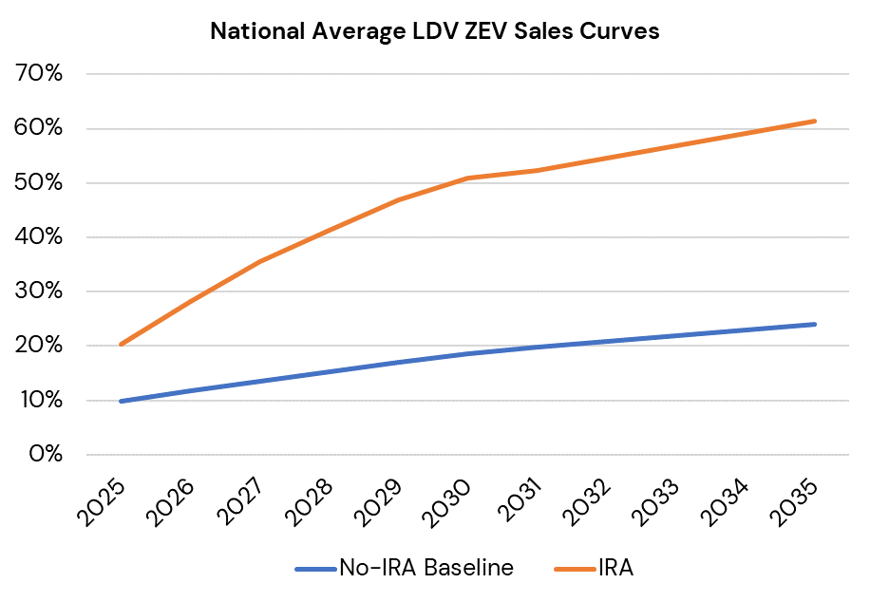
Transportation: Light Duty Vehicles (LDVs) Sales Curves
Sector Modeling Methodology
Two Sets of States
States that have not adopted California’s (CA’s) Advanced Clean Cars II (ACCII)^{1,2}
States that have adopted ACCII³
ACCII requires all new cars and passenger trucks sold by vehicle manufacturers to be zero-emissions by 2035
Many states have passed rules opting-in to the ACCII regulations
ACCII States⁴
Assumptions
IRA is unlikely to boost EV sales in ACCII states over the ACCII policy but will make implementing ACCII cheaper
IRA is likely to boost EV sales in non-ACCII states
Scenario Modeling Result
No-IRA baseline and IRA case is the same in ACCII states
Under IRA, EV sales increase in non-ACCII states
Through 2025 | CA
2026 | CA, MA, NY, OR, VT, WA
2027 and later | CA, CO, DC, DE, MA, MD, NJ, NM, NY, OR, RI, VT, WA
¹ U.S. Energy Information Administration (EIA). "Table 38:. Light-Duty Vehicle Sales by Technology Type."​ March 16, 2023. Accessed August 14, 2024. https://www.eia.gov/outlooks/aeo/data/browser/#/?id=48-AEO2023&region=1-0&cases=noIRA&start=2021&end=2050&f=A&sourcekey=0%E2%80%8B.
² See Table 81. Environmental Protection Agency (EPA). "Multi-Pollutant Emissions Standards for Model Years 2027 and Later Light-Duty and Medium Duty Vehicles." May 5, 2023. Accessed August 14, 2024. https://www.govinfo.gov/content/pkg/FR-2023-05-05/pdf/2023-07974.pdf.
³ See Table 105. Environmental Protection Agency (EPA). "Multi-Pollutant Emissions Standards for Model Years 2027 and Later Light-Duty and Medium Duty Vehicles." May 5, 2023. Accessed August 23, 2024. https://www.govinfo.gov/content/pkg/FR-2023-05-05/pdf/2023-07974.pdf.
⁴ California Air Resources Board. "States that have Adopted California's Vehicle Regulations..” Accessed August 14, 2024. https://ww2.arb.ca.gov/our-work/programs/advanced-clean-cars-program/states-have-adopted-californias-vehicle-regulations. At the time of modeling, VA was included as an ACCII state but has since decided to exit ACCII.

Slide 12
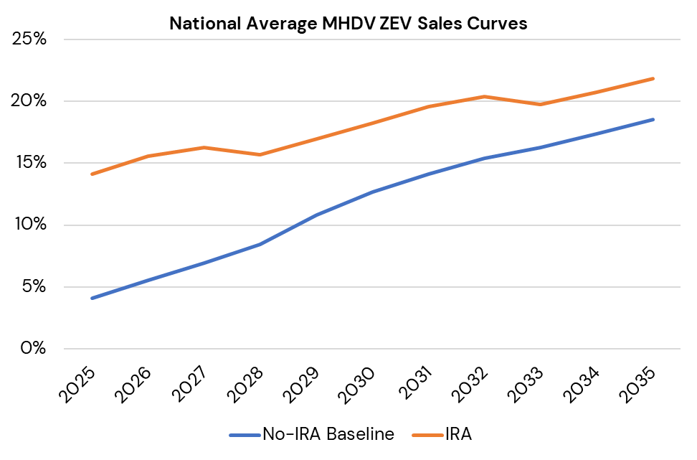
Transportation: Medium & Heavy-Duty Vehicles (MHDVs) Sales Curves
Sector Modeling Methodology
Two Sets of States
CA, which has adopted Advance Clean Fleets (ACF) regulation¹
All other states^{2,3,4}
Assumptions
IRA is unlikely to boost ZEV sales in CA over the ACF policy but will make implementing ACF cheaper
IRA is likely to boost ZEV sales in all other states
Medium and heavy-duty ZEV sales receive small incremental gain from IRA (about 5-10% over the no-IRA baseline)
Scenario Modeling Result
No-IRA baseline and IRA case is the same in CA
Under IRA, ZEV sales increase in all other states
¹ See Table A. Advanced Clean Fleets. “Final Regulation Order: Advanced Clean Fleets Regulation.” Accessed August 21, 2024. https://ww2.arb.ca.gov/sites/default/files/barcu/regact/2022/acf22/ac/acffro21.pdf
² Non ACF IRA curve derived from Figure 7 and Table 4. See Energy Innovation Policy and Technology LLC. “Implementing the Inflation Reduction Act: A Roadmap for State and Federal Transportation Policy.” October 17, 2022. Accessed August 21, 2024. https://energyinnovation.org/publication/implementing-the-inflation-reduction-act-a-roadmap-for-state-and-federal-transportation-policy/.
³ Non-ACF IRA curve also derived from Table V-2. See Environmental Protect Agency (EPA). “Greenhouse Gas Emissions Standards for Heavy-Duty Vehicles – Phase 3.” April 17, 2023. Accessed August 21, 2024. https://www.govinfo.gov/content/pkg/FR-2023-04-27/pdf/2023-07955.pdf
⁴ Non-ACF baseline derived from Table V-2. Ibid.

Slide 13
Transportation: Incentives
Sector Modeling Methodology
Estimating the Passenger Vehicle Tax Credit
Entities of concern provision of IRA can cause vehicles to be ineligible for the Clean Vehicle Tax Credit (30D) if supply chains include certain amounts of materials (e.g., critical minerals) from foreign entities of concern (China, Russia, North Korea, Iran)
Significant uncertainty over how many vehicles will be ineligible (Bloomberg NEF: 30-50%; Energy Innovation 50%¹)
ICF assumes that 50% will be eligible²
ICF assumes an average credit value of $5,000 based on an International Council on Clean Transportation (ICCT) study³
Commercial Vehicles
Vehicle receives the smallest of:
Maximum credit value
Incremental cost of ZEV compared to ICEV
30% of the vehicle CAPEX investments⁵
Light duty trucks | $7,500
Class 2b-3⁴ | $7,500
All others | $40,000
¹ U.S. Department of Energy (DOE). “Foreign Entity of Concern Interpretive Guidance.” May 2024. Accessed August 21, 2024. https://www.energy.gov/mesc/foreign-entity-concern-interpretive-guidance.
² See Page 2. Energy Innovation Policy and Technology LLC. “Implementing the Inflation Reduction Act: A Roadmap for State and Federal Transportation Policy.” October 17, 2022. Accessed August 21, 2024. https://energyinnovation.org/publication/implementing-the-inflation-reduction-act-a-roadmap-for-state-and-federal-transportation-policy/.
³See Table 1. International Council on Clean Transportation (ICCT). “Analyzing the Impact of the Inflation Reduction Act on Electric Vehicle Uptake in the United States.” January 2023. Accessed August 21, 2024. https://theicct.org/wp-content/uploads/2023/01/ira-impact-evs-us-jan23-2.pdf.
⁴ "Class 2b-3" means an on-road vehicle with a gross vehicle weight rating (GVWR) that is 8,501 pounds up to 14,000 pounds. https://ww2.arb.ca.gov/sites/default/files/barcu/regact/2019/act2019/fro2.pdf. Accessed August 21, 2024
⁵Internal Revenue Service (IRS). “Commercial Clean Vehicle Credit.” August 6, 2024. Accessed August 21, 2024. https://www.irs.gov/credits-deductions/commercial-clean-vehicle-credit.

Slide 14
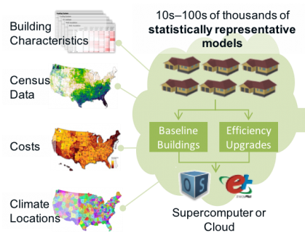
Buildings: Establish Baseline
Sector Modeling Methodology
National Renewable Energy Laboratory (NREL) ResStock and ComStock Building Stock Models
Granular, bottom-up models that use multiple data sources, statistical sampling methods, and advanced building energy simulations to estimate the annual sub-hourly energy consumption of residential and commercial building stock across the U.S.
Models provide detailed information on the technical and economic potential of residential and commercial energy efficiency improvements for 48 states, which can help policymakers, program designers, and manufacturers make decisions related to building decarbonization
Flexible and scalable: models can be used to analyze different geographic regions, building types, end uses, and efficiency measures. They can also be calibrated and updated with new data sets and modeling standards
Currently representative of 2018 building stock
Most recent year of available data

Slide 15
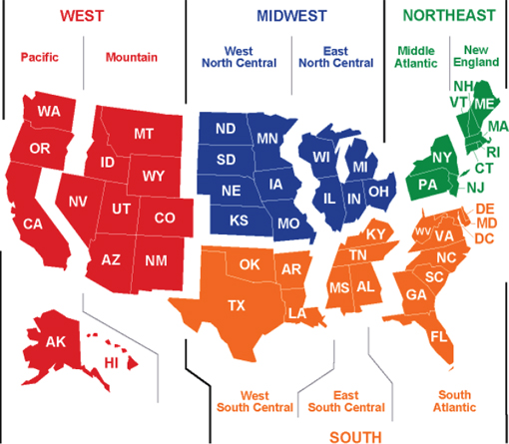
Buildings: Establish Baseline
Sector Modeling Methodology
Build baseline trend for energy use and emissions
Commercial growth and change
Residential growth and change
Select regional data matching REMI regional configuration for building types and characteristics
ComStock and ResStock data provide mix of building types, characteristics, and energy use for a specific region
ICF scales that information to baseline based on energy use trends

Slide 16
Buildings: Develop IRA Scenario
Sector Modeling Methodology
Buildings and no-IRA baseline inputs
ResStock and ComStock provide regional characteristics for buildings and households
Energy Information Administration (EIA) data are combined with building and household characteristics to build baseline projections of energy use (and emissions)
Developed investment targets
American Council for an Energy-Efficient Economy (ACEEE) Study¹ provides savings investment ratios for policies (MWh² change/$ invested, MMBTU³ change/$ invested)
Investments from IRA used to develop target MWhs and MMBTUs change for each section
Run tool iteratively to determine best fit
NREL’s Electrification Futures Study (EFS)⁴ provides measure penetration options
ICF runs DER Planner tool iteratively with different NREL EFS penetration curves to match savings and investments as closely as possible
Run building model iteratively to match total investment, and energy changes (electricity and natural gas) as closely as possible
¹ American Council for an Energy-Efficient Economy (ACEEE). “Clean Infrastructure: Efficiency Investments for Jobs, Climate, and Consumers.” September 2021. Accessed August 21, 2024. https://www.aceee.org/sites/default/files/pdfs/clean_infrastructure_final_9-20-21.pdf.
² MWh – megawatt hour
³ MMBTU – Million Metric British Thermal Unit
⁴ National Renewable Energy Laboratory (NREL). “Electrification Futures Study.” Accessed August 14, 2024. https://www.nrel.gov/analysis/electrification-futures.html.

Slide 17
Hydrogen
Sector Modeling Methodology
Hydrogen scenario outputs derived from ACP and Wood Mackenzie’s report, Implications of 45V Guidance for the Future of the Green Hydrogen Industry¹
ACP report estimates levelized cost of hydrogen (LCOH) combined with sector demand curves to project hydrogen production
Both hydrogen produced by clean electrolysis (i.e., green hydrogen) and Steam Methane Reforming (SMR) with CCS (i.e., blue hydrogen)
Derived scenario outputs using ACP report results associated with annual matching methodology
Electrolyzer demand is met annually by renewables but needs grid power supply to sustain continuous operations
Renewable energy credits from excess renewable generation in peak generation hours are used to verify renewable attributes of grid supplied power
ICF integrated renewable generation requirements for green hydrogen into IPM (Power) modeling
Additional renewable supply meets the incremental hydrogen demand assumed from green hydrogen consumption
For each region with demand for green hydrogen, incremental renewable capacity required to supply green hydrogen production was assumed based on:
Regional renewable supply and performance assumptions
Capacity already built absent green hydrogen demand induced capacity additions
The capacity required to meet the incremental hydrogen demand incurred additional capital and maintenance expenses and received additional production tax credits (PTCs) based on its generation
¹ American Clean Power. "Implications of 45V Guidance for the Future of the Green Hydrogen Industry." Accessed August 8, 2024. https://cleanpower.org/wp-content/uploads/gateway/2024/02/ACP-Wood-Mackenzie_Implications-of-45V-Guidance-to-the-Green-Hydrogen-Industry_Executive-Summary.pdf. Final regulatory guidance has not been issued as of the date of this report’s publication. The structure of those final rules may lead to different results.

Slide 18
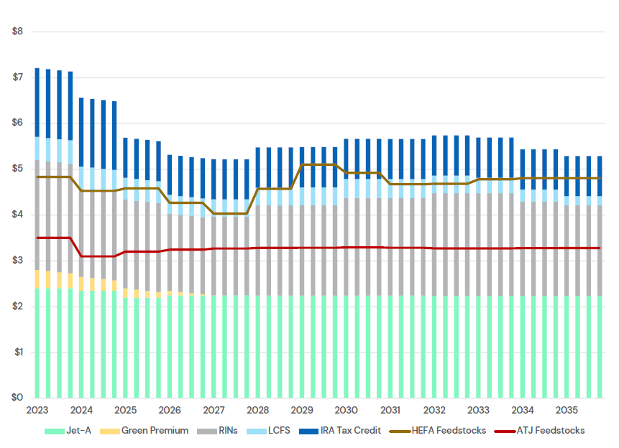
Sustainable Aviation Fuel
Sector Modeling Methodology
SAF analysis developed based on market analysis of SAF value; includes consideration of the following compared with SAF costs (e.g., feedstock, transportation, and SAF production):
Jet A—an aviation kerosene-type fuel used in gas-turbine engine aircrafts. Base value for jet-fuel
Renewable Identification Numbers (RINS)—credits used for compliance under the U.S. Renewable Fuel Standard (RFS) Program¹
California Low Carbon Fuel Standard (LCFS) credit²
IRA SAF credits
Jet-A forecast is based on West Texas Intermediate (WTI) forecasts and historic Jet-A crack spreads³
RINs and LCFS credits are estimated from forecasting that responds to market dynamics
Hydroprocessed esters and fatty acids (HEFA) SAF pathway feedstock costs are represented as an average per gallon cost
Alcohol-to-jet (ATJ) SAF pathway feedstock costs are derived from ethanol forecasts
SAF Production Costs and Value Streams
$/gallon
¹ U.S. Environmental Protection Agency. “Renewable Identification Numbers (RINs) under the Renewable Fuel Standard Program.” Accessed August 13, 2024. https://www.epa.gov/renewable-fuel-standard-program/renewable-identification-numbers-rins-under-renewable-fuel-standard.
² California Air Resources Board. “Low Carbon Fuel Standard.” Accessed August 13, 2024. https://ww2.arb.ca.gov/our-work/programs/low-carbon-fuel-standard.
³ Crack spreads represent the price difference between crude oil and its refined products. U.S. Energy Information Administration. “What Drives Petroleum Product Prices?” Accessed August 13, 2024. https://www.eia.gov/finance/markets/products/prices.php.

Slide 19
Sustainable Aviation Fuel: Assumptions
Sector Modeling Methodology
Assumption | Description
Expansion of both HEFA and ATJ SAF production will expand like HEFA renewable diesel production | Because historic data on the expansion of SAF production is unavailable, ICF looks to a corollary: the renewable diesel (RD) market. RD and SAF share important characteristics. For HEFA, the production process and inputs are similar, as RD is also a HEFA product, and they share the same feedstock. Both RD and SAF also enjoy an uncapped market. RD is the only low carbon diesel replacement that is a perfect chemical substitute, and therefore its growth is not hampered by competitors, like SAF.
Green premium | ICF assumes SAF producers will enjoy a “green premium” that reflects the willingness of airlines who are first movers in reducing their carbon emissions to pay a premium for SAF, especially given the lack of supply relative to current demand. ICF assumes the premium decreases over time as more SAF producers enter and compete in the market.
Feedstock prices will not react to SAF production | ICF purchases data on soybean and used cooking oil price forecasts from The Jacobsen, which account for anticipated increases in feedstock demand based on increased SAF and RD production.
Jet-A prices will not react to SAF production | ICF assumes that increased SAF production will not change the price of Jet-A given initial small volumes of SAF production relative to total Jet-A demand in the U.S., and uncertainty surrounding the long-term jet fuel market.
Incentive values (RFS and LCFS) will not react to SAF expansion | RFS and LCFS forecasts account for SAF expansion, and therefore ICF assumes that IRA-induced SAF will not change incentive values.

Slide 20
Manufacturing
Sector Modeling Methodology
CBO and IRS provide estimates¹ of spending for 45X (~$30 billion) and 48C (~$10 billion)
Assumes the 48C incentives are distributed over 10 years and the 45X incentives are distributed through 2032
45X incentives reduce production cost for manufacturing firms, modeled directly in REMI
ICF calculated investment in new or expanded manufacturing facilities associated with 48C
Credit is up to 30% of the qualified investment if it meets prevailing wage and other factors
ICF assumed a bit less than this in the form of a “leverage ratio”
Public subsidies attract private investment. ICF assumed a leverage ratio of 4, and therefore $10 billion attracts an additional $40 billion of private investment (totaling $50 billion)
48C CAPEX investments ($50 billion) leads to ongoing jobs to operate the manufacturing facilities
ICF calculated direct ongoing jobs based on average jobs/$ for different manufacturing sectors
¹ Congressional Research Service. “Inflation Reduction Act of 2022 (IRA): Provisions Related to Climate Change.” October 26, 2023. Accessed April 28, 2024. https://crsreports.congress.gov/product/pdf/R/R47262.

Slide 21
REMI Methodology

Slide 22
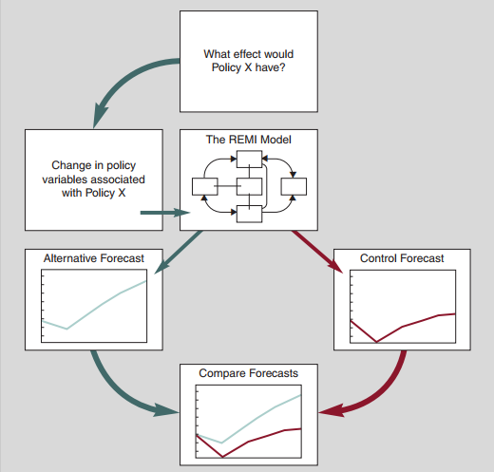
REMI Model Background
Overall REMI Modeling Methodology
REMI is a dynamic macroeconometric model
The model uses a combination of input-output, econometric and computable general equilibrium (CGE) modeling techniques
Calibrated to most recent regional and industry data
Census regions and North American Industry Classification System (NAICS)-based industry classification
Provides the ability to analyze detailed distributional impacts
REMI estimates impacts over time
Produces robust short-and long-term impacts

Slide 23
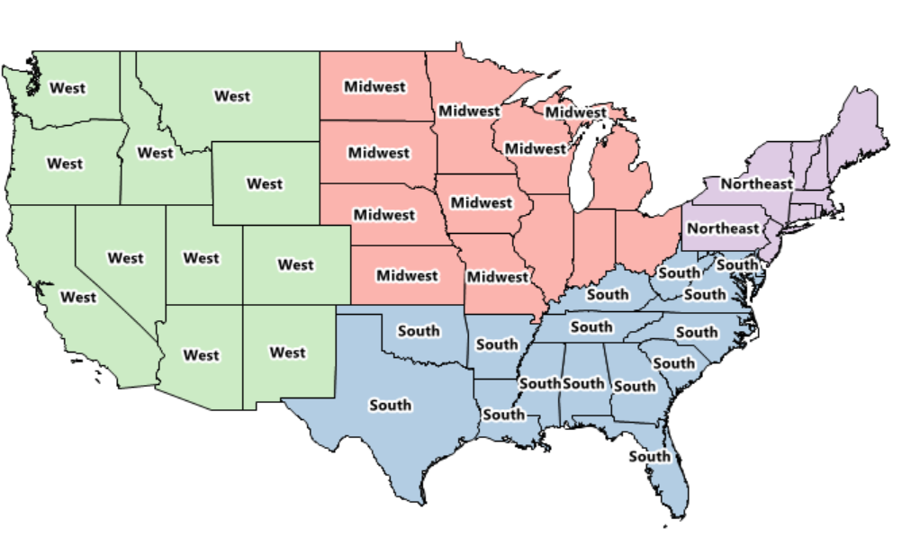
REMI Model Configuration and Outputs
Overall REMI Modeling Methodology
4-Region Model: West, Midwest, South, and Northeast
70-Sectors: typically, 2- or 3-digit NAICS codes¹
REMI Model outputs key result variables
Employment: estimates of the number of jobs, full-time plus part-time
Gross Domestic Product (GDP): the market value of goods and services produced by labor and property. Also, the sum of value-added across all industries
Disposable Personal Income (DPI): total after-tax income received by households; the income available for spending or saving
Includes wages from jobs as well as income from other sources
¹ NAICS classifies business establishments in the U.S. based on similarities in the processes used to produce goods or services. NAICSs codes range from 2 to 6 digits, with higher digit codes representing more specific industries. U.S. Census Bureau. “North American Industry Classification System”. Accessed August 13, 2024. https://www.census.gov/naics/ and https://www.census.gov/programs-surveys/economic-census/year/2022/guidance/understanding-naics.html.

Slide 24
REMI Modeling Inputs
Overall REMI Modeling Methodology
Outputs from sector modeling are converted into REMI modeling inputs
REMI modeling inputs include:
Capital expenditures (CAPEX)
Household spending on goods and services
Operation and maintenance (O&M) expenditures (OPEX)
Bill savings (from change in fuel consumption)
Increase in money available to residential consumers to spend in the rest of the economy
Fuel production impacts
For fossil producing industries, a decline in demand for their products
Somewhat offset by export opportunities
CAPEX opportunity costs
Investments could be made in other areas of the economy; REMI modeling captures that opportunity cost
Household spending opportunity costs
Households that purchase equipment (e.g., solar panels) have alternative opportunities in the economy to spend their income
Cost of funding IRA incentives
Incentives paid out by federal government require funding
IRA specifies tax policy changes to fund IRA spending. Taxes to fund spending include the corporate alternative minimum tax and an excise tax on repurchase of corporate stock

Slide 25
State Downscaling

Slide 26
State Level Results
State-level results apportionment
Regional REMI results are apportioned to states based on assumptions of state-level economic activity
Sector-specific apportionment dependent on sector modeling types, cost component modeled in REMI, and data availability
Sector modeling with state results (IPM, MOVES4)
State-level resolution available for sector outputs
REMI results for specific cost components and industries are downscaled to the state level when jobs are expected to be proportional to location of the sector activity
Example: IPM projects state-level generation capacity
Construction jobs assumed to be concentrated within the state where new generation capacity is built
Regional construction jobs associated with generation CAPEX downscaled using state-level generation capacity data
Other sectors with less state detail, or industry results with geographically disperse supply chains
Census County Business Patterns (CBP) data used for apportionment
Example: Manufacturing supply chains may extend out of state
If REMI results indicate Y jobs in computer products manufacturing in the Northeast, and New York has X% of these jobs, then X% * Y jobs assumed to occur in New York
Downscaling supplemented with additional data as necessary
For example, green and blue hydrogen are a nascent industry with less historical data available to project state-level job impacts
Therefore, 2035 DecarbAmerica¹ hydrogen production estimates by state are used to project what states will have higher concentrations of hydrogen economic impacts
¹Decarb America. “Hydrogen Production”. Accessed October 3, 2024. https://decarbamerica.org/interactive-maps/hydrogen-production/

Slide 27
Acronyms
ACCII | Advanced Clean Cars II
ACEEE | American Council for an Energy-Efficient Economy
ACF | Advanced Clean Fleets
ATJ | Alcohol-to-Jet
BEV | Battery Electric Vehicle
CAPEX | Capital Expenditures
CBO CBP | Congressional Budget Office County Business Patterns
CCS | Carbon Capture and Storage
CGE | Computable General Equilibrium
DER | Distributed Energy Resource
DPI DOE | Disposable Personal Income Department of Energy
E/C | Engineering and Construction
EFS | Electrification Future Study
EIA | Energy Information Administration
EPA | Environmental Protection Agency
EV | Electric Vehicle
FCEV | Fuel Cell Electric Vehicle
GDP | Gross Domestic Product
GHG | Greenhouse Gas
GVWR | Gross Vehicle Weight Rating
HEAR | Home Electrification and Appliance Rebates
HEFA | Hydroprocessed Esters and Fatty Acids
HOMES | Home Efficiency Rebates
ICCT | International Council on Clean Transportation
ICEV | Internal Combustion Engine Vehicle
IPM | Integrated Planning Model
IRA | Inflation Reduction Act
IRS | Internal Revenue Service
LCFS | Low Carbon Fuel Standard
LCOH | Levelized Cost of Hydrogen
MHDV | Medium-Heavy Duty Vehicle
MMBTU | Million Metric British Thermal Unit
MOVES4 | Motor Vehicle Emission Simulator
MWh | Megawatt Hour
NAICS | North American Industry Classification System
NREL | National Renewable Energy Laboratory
O&M | Operation and Maintenance
OPEX | Operational Expenditure
PHEV | Plug-in Hybrid Electric Vehicle
PTC | Production Tax Credit
PV | Photovoltaic
RD | Renewable Diesel
RFS | Renewable Fuel Standard
RINS | Renewable Identification Numbers
SAF | Sustainable Aviation Fuel
SMR | Steam Methane Reforming
VMT | Vehicle-Miles Traveled
VOM | Variable Operation and Maintenance
WTI | West Texas Intermediate
ZEV | Zero-Emission Vehicle

